Slide 1
HACKBIO INTERNSHIP MACHINE LEARNING AND DATA SCIENCE TRACK TOPIC:CLASSIFICATION OF CLINICAL STAGES OF LIVER CANCER USING MACHINE LEARNING
GROUP NAME: DATA ALCHEMISTS
PRESENTER: ADEKOYA ADEPEJU
DATE: 12TH OCTOBER, 2024.

Slide 2

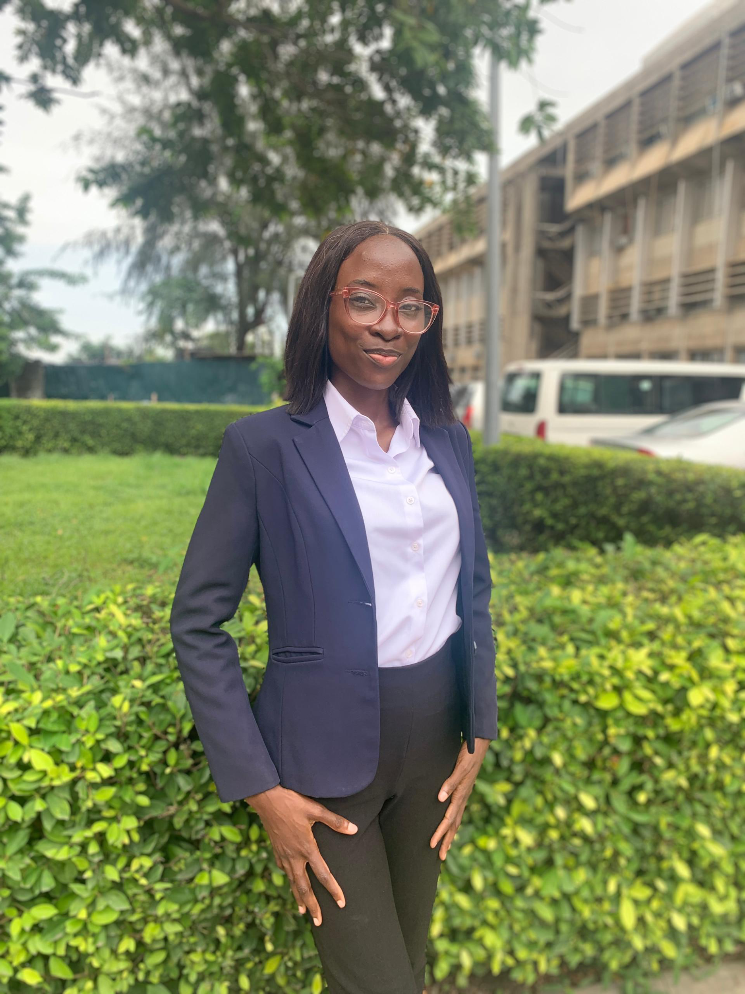

DATA ALCHEMISTS TEAM MEMBERS
MELVIN KHAKABO
Lead Coder,
Dataset Verifier,
Model Implementation and optimization,
Social Media Representative
ADEKOYA ADEPEJU
Dataset Miner,
Pipeline Developer,
Collaborative Coder,
Scientific Writer
NIGUSE KELILE LEMA
Scientific Writer,
Manuscript Proofreader,
Collaborative Coder,
Workflow Coordinator,
Final Draft Coordinator

Slide 3
BACKGROUND OF THE STUDY
Liver cancer is the sixth most common and the third leading cause of cancer death globally (NCI, 2024).
Accurate detection and classification are crucial for timely treatment (Jesi & Daniel, 2024).
AI improves accuracy and efficiency in interpreting medical images such as CT-scans and MRIs (Khalifa & Albadawy, 2024).
Our study will leverage machine learning to improve liver cancer stage classification, aiming for earlier intervention and personalized therapies.

Slide 4
PROJECT WORKFLOW FLOWCHART
Data Collection
Source: TCGABiolinks
Description: Liver cancer patient data, transcriptome profiling and clinical data
Data Pre-processing
Data Cleaning and Normalization
Feature Selection: Select relevant features (e.g., top genes, clinical markers) for classification.
Model Development
Train-Test Split: Split the data into training (80%) and testing (20%) sets.
Machine Learning Algorithms (KNN and Random Forest)
Cross Validation
Evaluation & Validation
Metrics: Use accuracy, precision, recall, and confusion matrices to assess performance.
Manuscript Development

Slide 5
EXPECTED OUTCOME AND POTENTIAL OF THE STUDY
Expected Results:
Analysis of the machine learning models using transcriptomic data and Clinical metadata for liver cancer classification.
Evaluation of model performance through accuracy, precision, and recall.
Investigate the long term potential of this research in improving early detection enabling personalized treatment and contributing to advancement in liver cancer and diagnostics.

Slide 6


